Slide 1
Managing the Cloud Project: Analyzing Crime Data Using Cloud Services
Alok Sahu
Ramya Chandrashekar
Venkata Siva Abhishek Munukutla
Mohan Suraj Lakshmi Narayana
Supervisor: Thomas Pearson

Slide 2
Introduction
Controlling crime is a challenging task.
Analyzing historic crime data gives a few workable suggestions to improve the prevailing order of the city.
In this project, we are analyzing crime data of Los Angeles.
We created a cloud based service that processed large amounts of crime data and generated reports.
These analysis reports are a comprehensive representation of the useful information harnessed from plain big data.

Slide 3
Getting the Data
Data set for analysis is downloaded from data.gov.
This dataset reflects incidents of crime in the City of Los Angeles.
Data can be dated back to 2010.
It consists of a million records with 26 fields each that describes the nature of crime, like date and time the crime occurred, location, crime code, weapon used, victim age etc.
Using the above data we have come up with 5 scenarios for data analysis.

Slide 4
Use Cases for Analysis
Crime rate based on time of the day
01
Crime rate based on sex and age
02
Crime rate based on location
03
Weapons used in crime
04
Top 6 lethal weapons used in recorded crimes
Crime rate based on street
05
Crime rate based on type of crime for the chosen street

Slide 5

Storage Setup
File format of the big data file used is .txt.
Amazon EMR requires input files to be stored in the S3 bucket.
To run Hadoop Map reduce jobs on Amazon EMR, input file should be in .txt format.
The input file, job file and output files are all stored on Amazon S3 bucket.
Amazon S3 provides cloud storage through the web services interface.

Slide 6
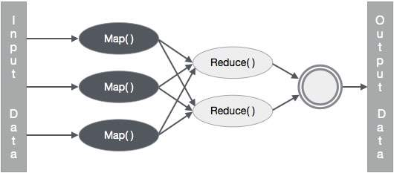
Map Reduce Jobs for Analysis
We ran Hadoop MapReduce jobs to analyze data.
Apache Hadoop is an open-source software framework used for distributed storage and processing of dataset of big data using the MapReduce programming model.
MapReduce is a programming model for processing and generating big data sets with a parallel, distributed algorithm on a cluster.
The Map() performs filtering and sorting and Reduce() performs a summary operation .
Each Use case has its own job with a mapper and reducer component to compute the results.

Slide 7
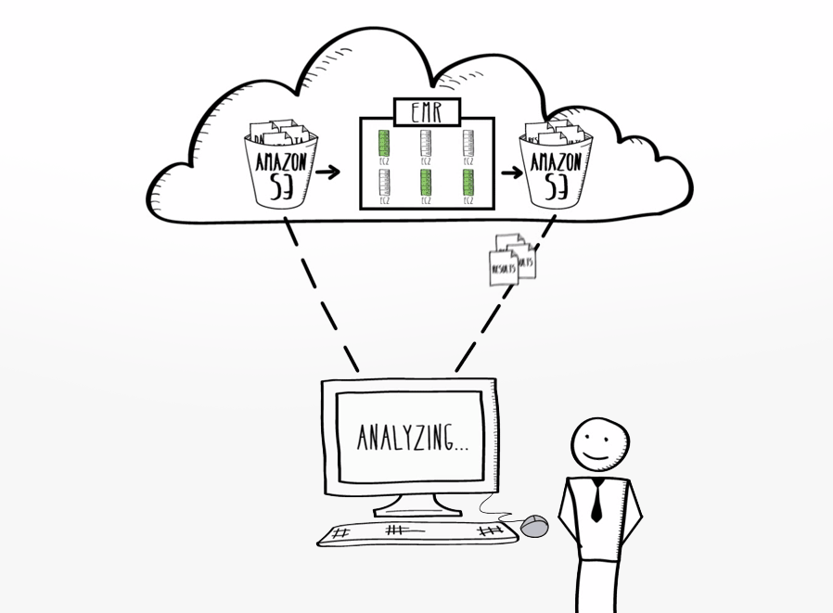
Cloud Service Implementation
A distributed processing system is setup with the help of Amazon EMR (Elastic Map Reduce)
Amazon EMR is a Software as a Service(SaaS).
Amazon EMR is a web service that makes it easy to process large amounts of data efficiently.
Amazon EMR uses Hadoop processing combined with several AWS products to do such tasks as web indexing, data mining, log file analysis, machine learning, scientific simulation, and data warehousing.

Slide 8
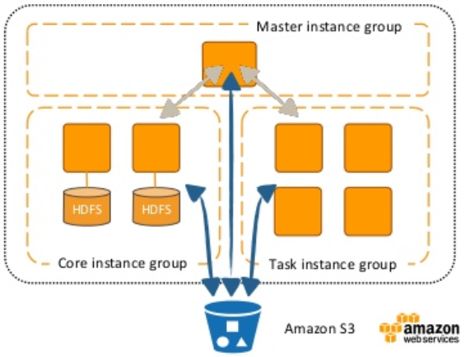
Cloud Service Implementation
All the jobs for different use cases are stored in a single .jar file.
The map reduce job, input file and output location are set as arguments during EMR instance creation
We use the step execution feature of the EMR cluster.
The use cases are set as multiple steps for the same cluster.
Once the cluster is created, it executes each use case one by one.
At the end of the successful execution the cluster is terminated based on our setting.

Slide 9
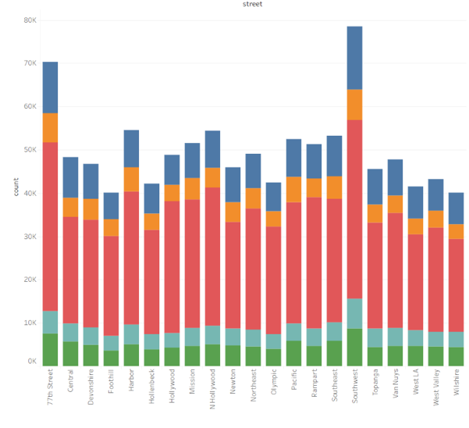
Visualization of the Results
Tableau is used for data visualization.
Tableau is an interactive data visualization tool focused on business intelligence. It gives a user the ability to perform fairly complex data visualization in a very intuitive, drag and drop manner.
Its data visualization is also impressively interactive.
Multiple output files are created for each use case by the different nodes in the cluster.

Slide 10
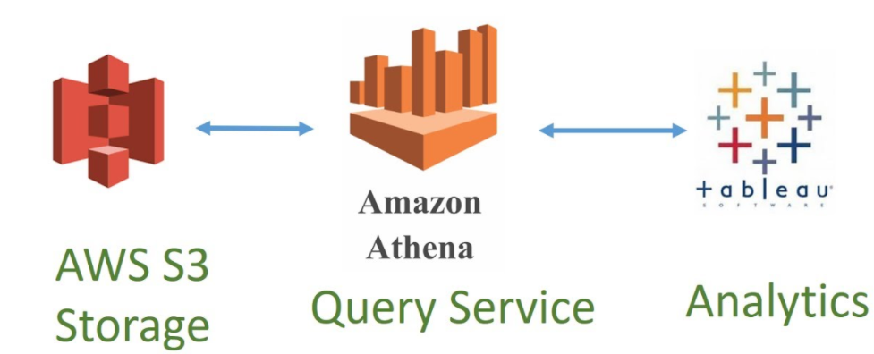
Visualization of the Results
We save the data chunks as a single unit in a database on Amazon Athena.
Tableau Desktop uses these data tables as a Data Source.
Dashboards are created to represent the Analysis of each use case.
The entire workbook containing the dashboards are uploaded on the Tableau Public web server.
The workbook containing the analysis results can be accessed through the link here.

